Slide 1
Euglena

Slide 2
Euglena
Are single-celled organisms with the following structures or organelles: mitochondria, nucleus, vacuole, Golgi apparatus, endoplasmic reticulum, and flagella.
Euglena are unique in that the outer layer of the cell includes a flexible membrane called the pellicle.

Slide 3
The pellicle supports and contains the plasma membrane, much like a cell wall would in plants. They may also have an eyespot or photoreceptor that functions as a light sensor

Slide 4
Euglena is classified as:
Kingdom: Protista
Sub Kingdom: Protozoa
Phylum: Sarcomastigophora
Subphylum :Mastigophora
Order :Euglenida

Slide 5
Euglena
is a genus of unicellular, flagellated microorganisms. They possess characteristics of both plants and animals but are neither placed in the kingdom Plantae nor Animalia. They belong to the kingdom Protista.

Slide 6
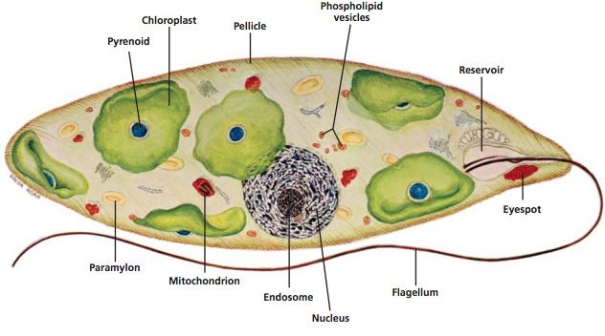
Euglena

Slide 7
Eyespot helps them sense light. Can be autotrophic (produces their own food)
Waste- Contractile Vacuole holds excess water and removes it from the cell.
Movement- Flagella

Slide 8
Nutrition
Euglena contains chloroplast having chlorophyll.
They perform photosynthesis
Some of the photosynthetic euglenoids lose their chlorophyll when they grow in the dark and obtain nutrients heterotrophically from organic matter

Slide 12
Reproduction Euglena reproduces asexually by binary fission, they divide longitudinally

